Slide 1
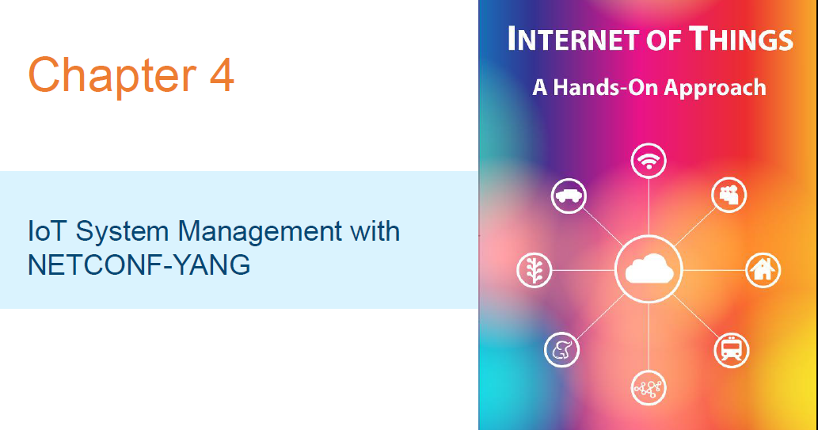

Slide 2
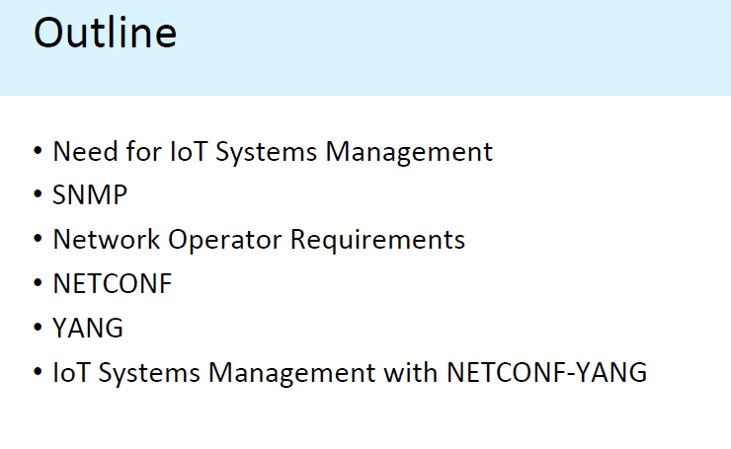

Slide 3
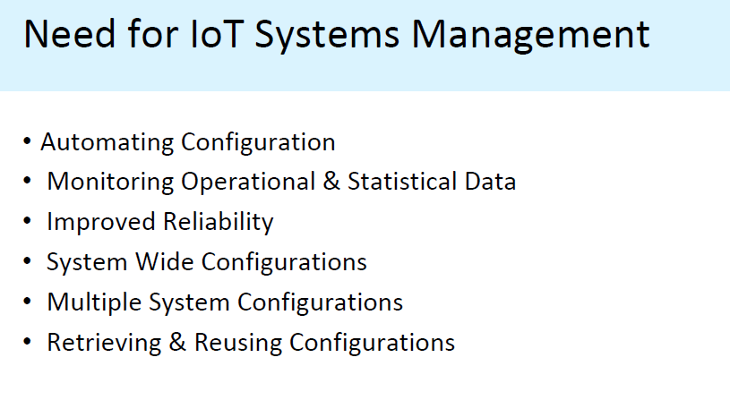
Need for Iot Systems

Slide 4
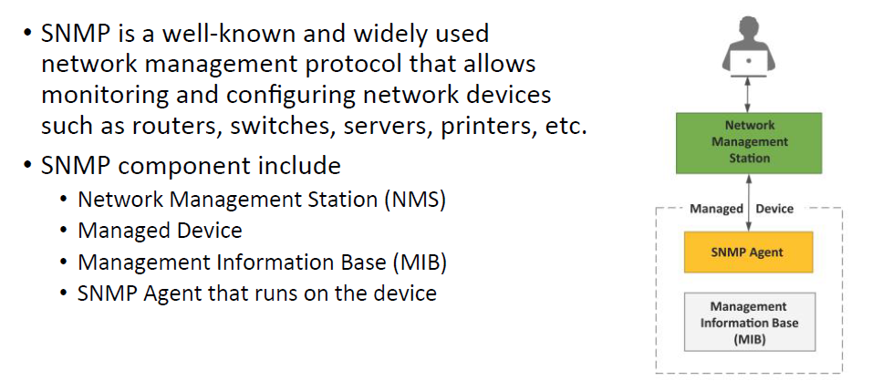
Simple Network Management Protocol

Slide 5
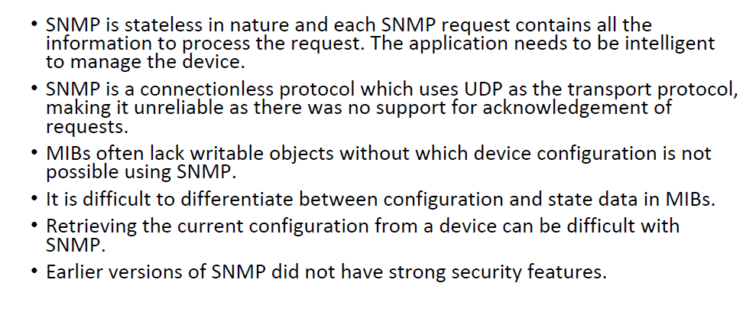
Limitations of SNMP

Slide 6
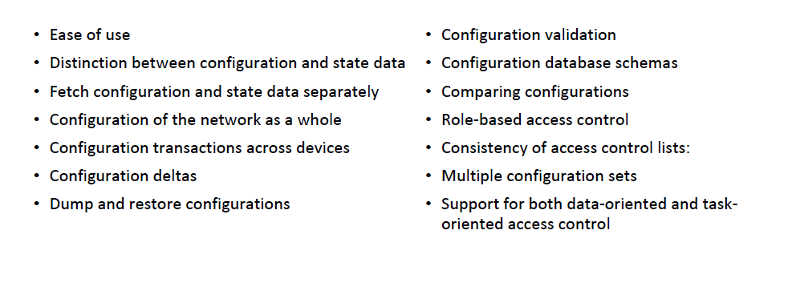
Network Operator Requirements

Slide 7
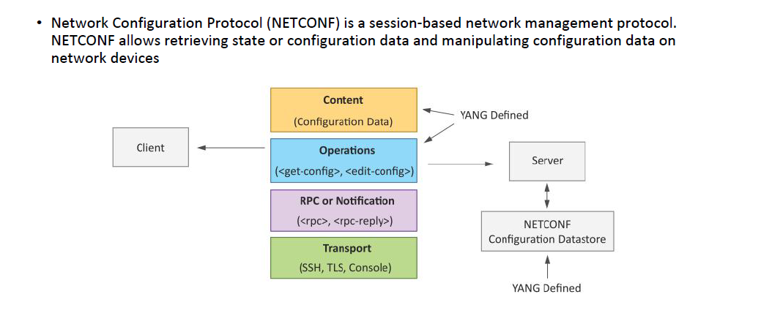
NETCONF

Slide 8
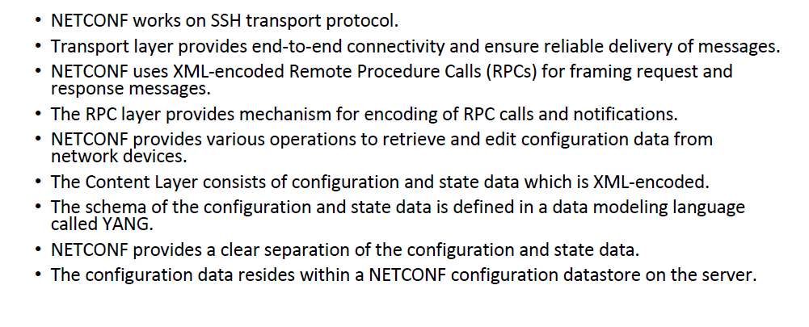
NETCONF

Slide 9
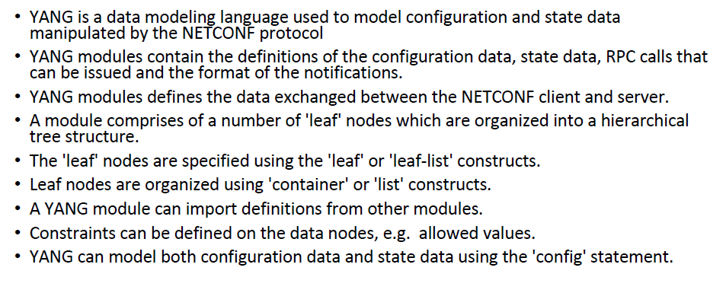
YANG

Slide 10
Operation | Description
Connect | Connect to a NETCONF server
Get | Retrieve the running configuration and state information
Get-Config | Retrieve all or a portion of a configuration data store
Edit-Config | Loads all or part of a specified configuration to the specified target configuration
Copy-Config | Create or replace am entire target configuration data store with in complete source configuration
Delete-Config | Delete the contents of a configuration data store
lock | Lock a configuration data store for exclusive edits by a client
unlock | Release the lock on a configuration data store
Get-schema | To retrieve a schema from the NETCONF server
Commit | Commit the candidate configuration as the device’s new current configuration
Close-session | Gracefully terminate a NETCONF Session
Kill-session | Forcefully terminate a NETCONF Session

Slide 11
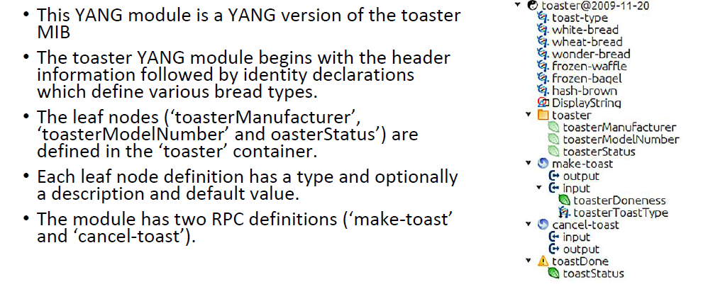
YANG MODULE EXAMPLE

Slide 12
Yang Node Types
Node Type | Description
Leaf Nodes | Contains data structure like int or string. It has one value of a particular type and no child nodes.
Leaf-List Nodes | Is a sequence of leaf nodes with exactly one value of a particular type per leaf
Container Nodes | Used to group related nodes in a sub tree. A container has any number of child nodes of any type(leafs ,lists and containers
List Nodes | Defines a sequence of list entries. Each entry is like a structure or a record instance and uniquely identified bt=y the values of its key leafs.

Slide 13
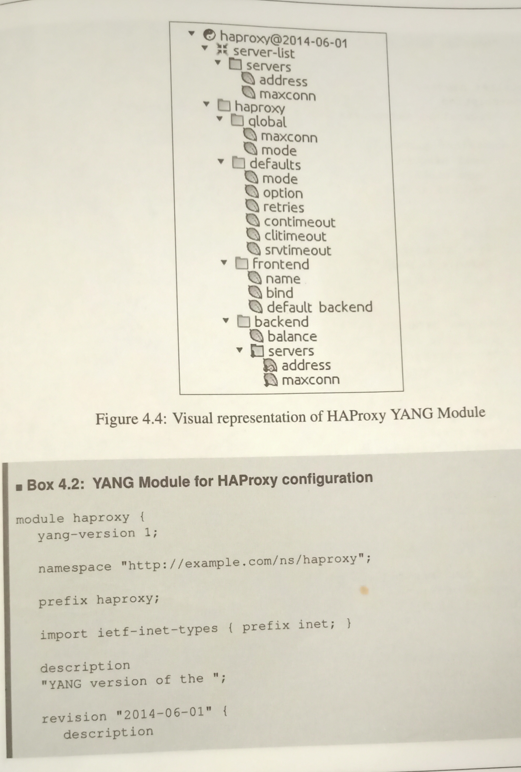
HAProxy YANG Module

Slide 14
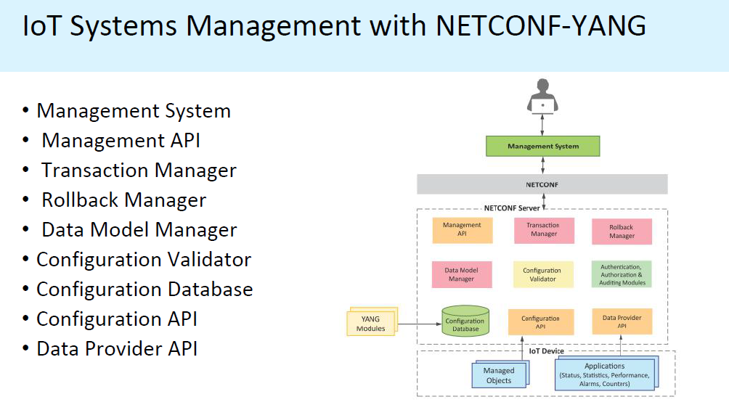
IOT Systems Management with NETCONF-YANG

Slide 15
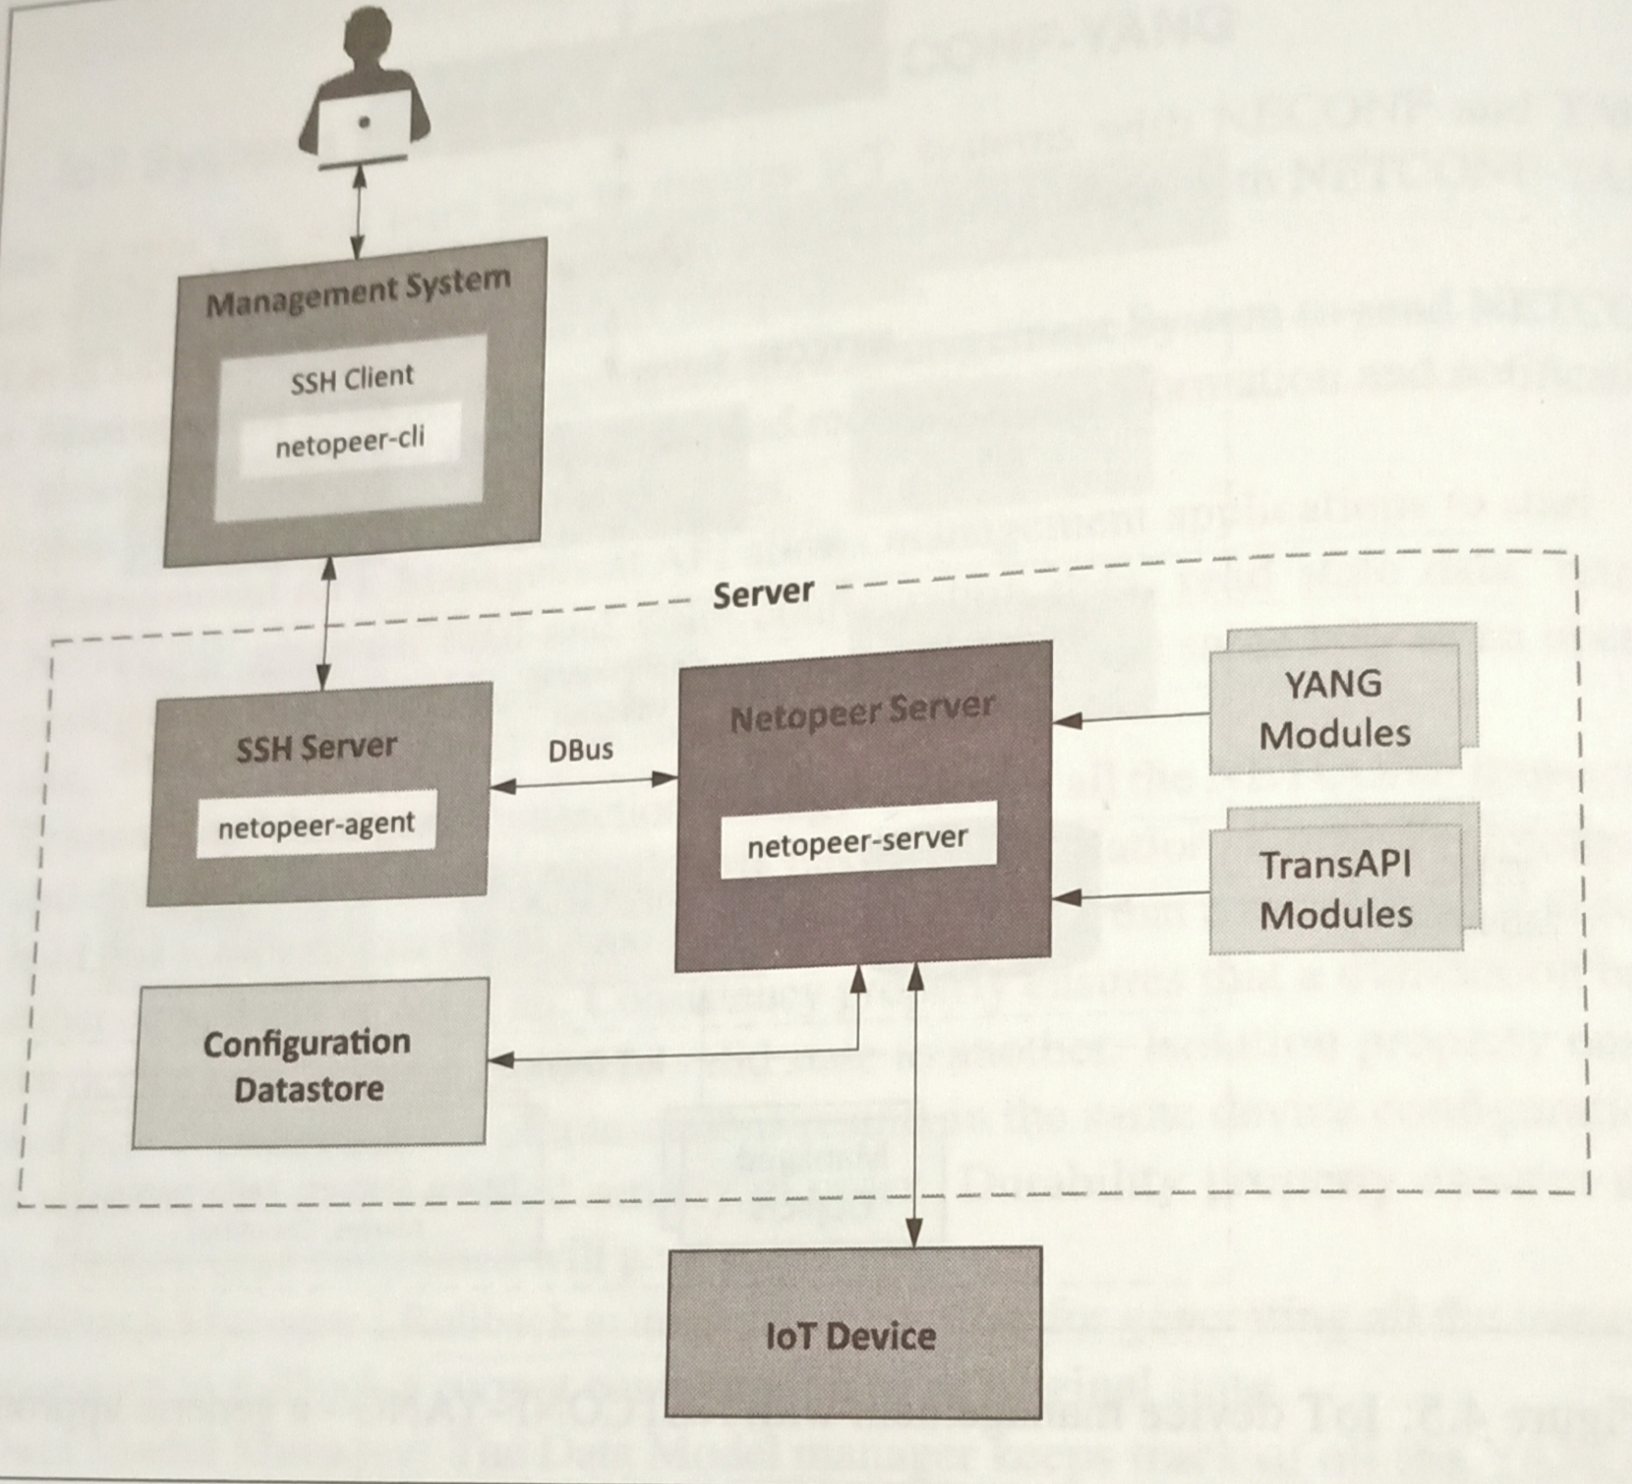
IOT Device Management with NETCONF

Slide 16
Netopeer tools
Netopeer-server
Netopeer-agent
Netopeer-cli
Netopeer-manager
Netopeer-configurator

Slide 17
Steps for IoT device Management with NETCONF-YANG
Create a YANG model of the system that defines the configuration and state data of the system.
Compile the YANG model with the ‘Inctool’ which comes with Libnetconf. Libnetconf provides a framework called Transaction API(TRANSapi) that provides a mechanism of reflecting the changes in the configuration file in the actual device.
Fill in the IOT device management code in the TransAPI module. This file includes configuration call backs,RPC callbacks and state data callbacks.
Build the callbacks C file to generate the library file(.so)
Load the YANG module
The operator can now connect from the management system to the Netopeer server using Netopeer CLI
Operator can issue NETCONF commands from the Netopeer CLI.

